Slide 1
Episode 4:
Social Networks

Slide 2
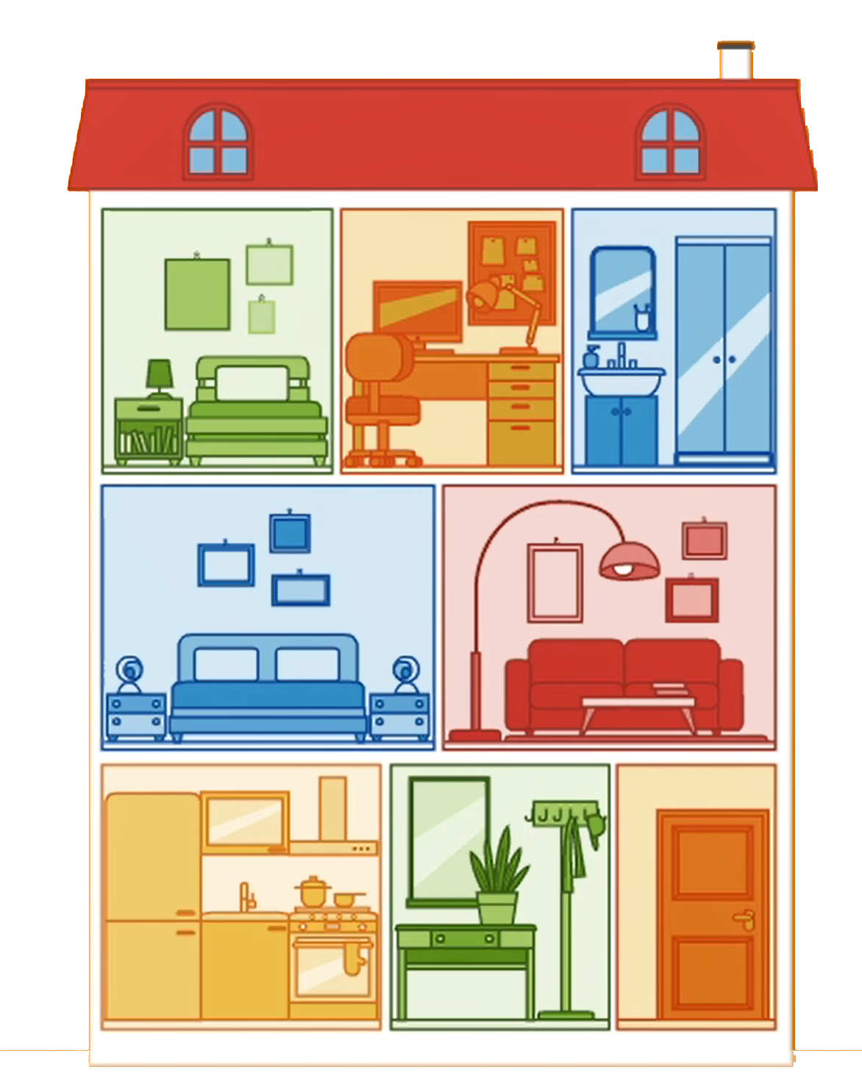
Your smartphone or your tablet are your
digital houses

Slide 3
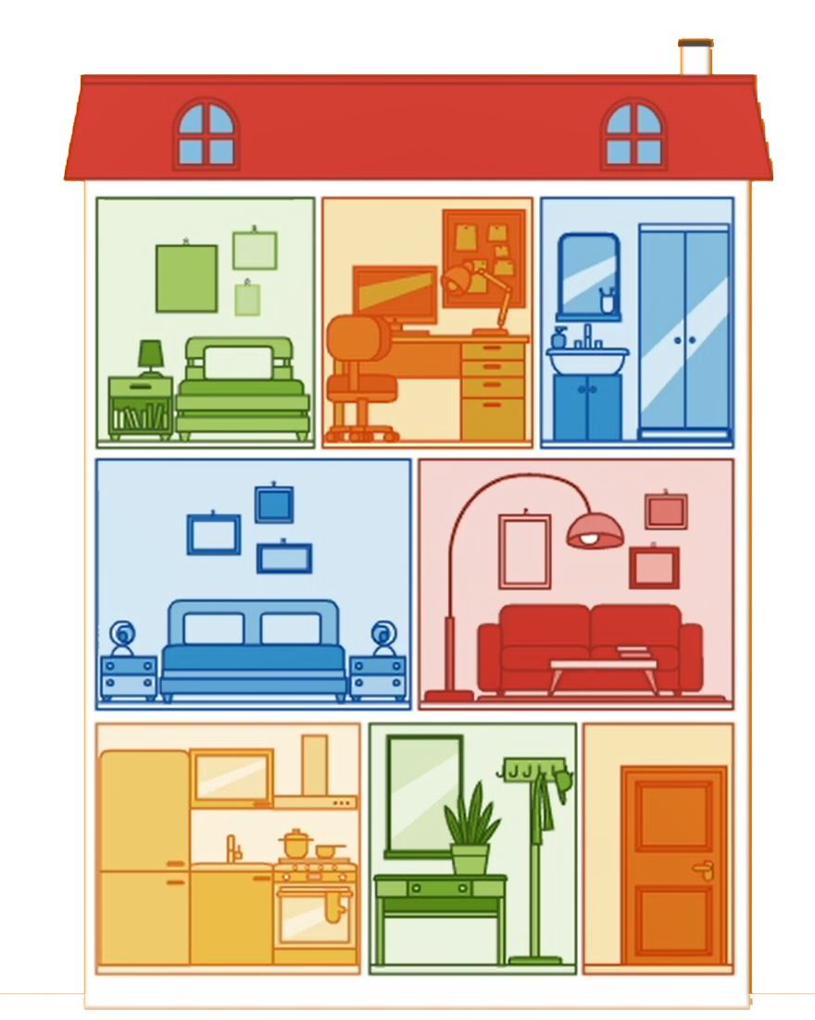
Information
⬤ Photos
⬤ Photos of your friends
⬤ Chat
⬤ Location
⬤ First name
⬤ Last name
⬤ Birthday
⬤ Phone number
⬤ Chat with friends
⬤ Secret information

Slide 4
Social Networks

Slide 5
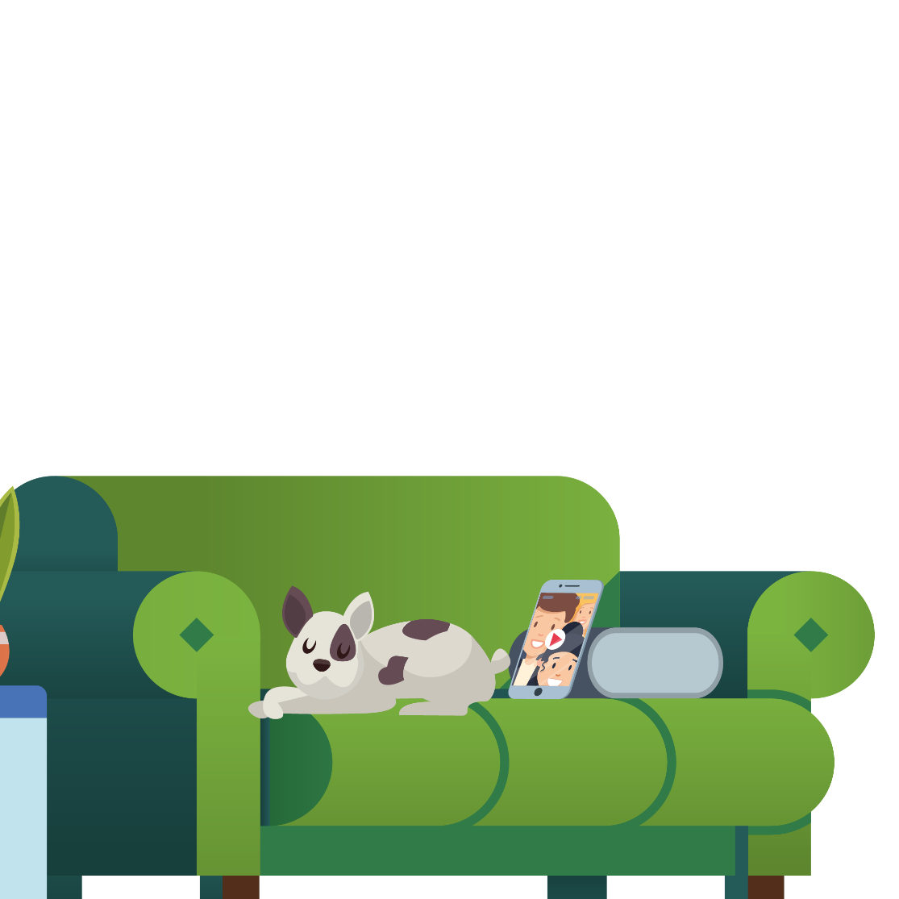
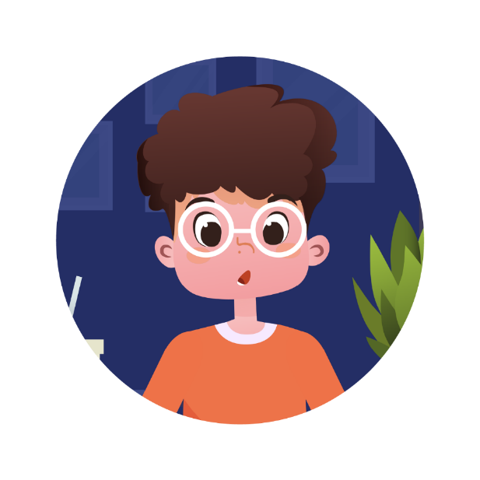
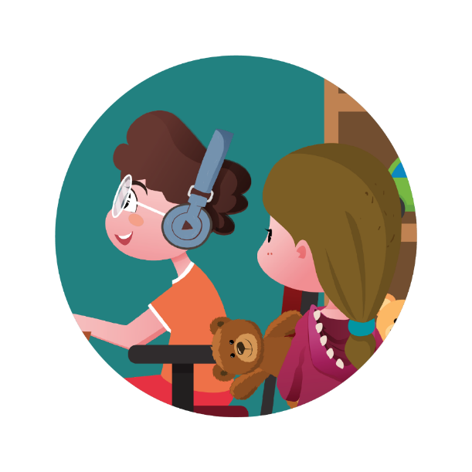
Social Networks
Social networks are places where you connect with other people online, where you can exchange ideas and interact with one another, wherever you are and whenever you want.
Communicate, share, stay connected with your friends.

Slide 6
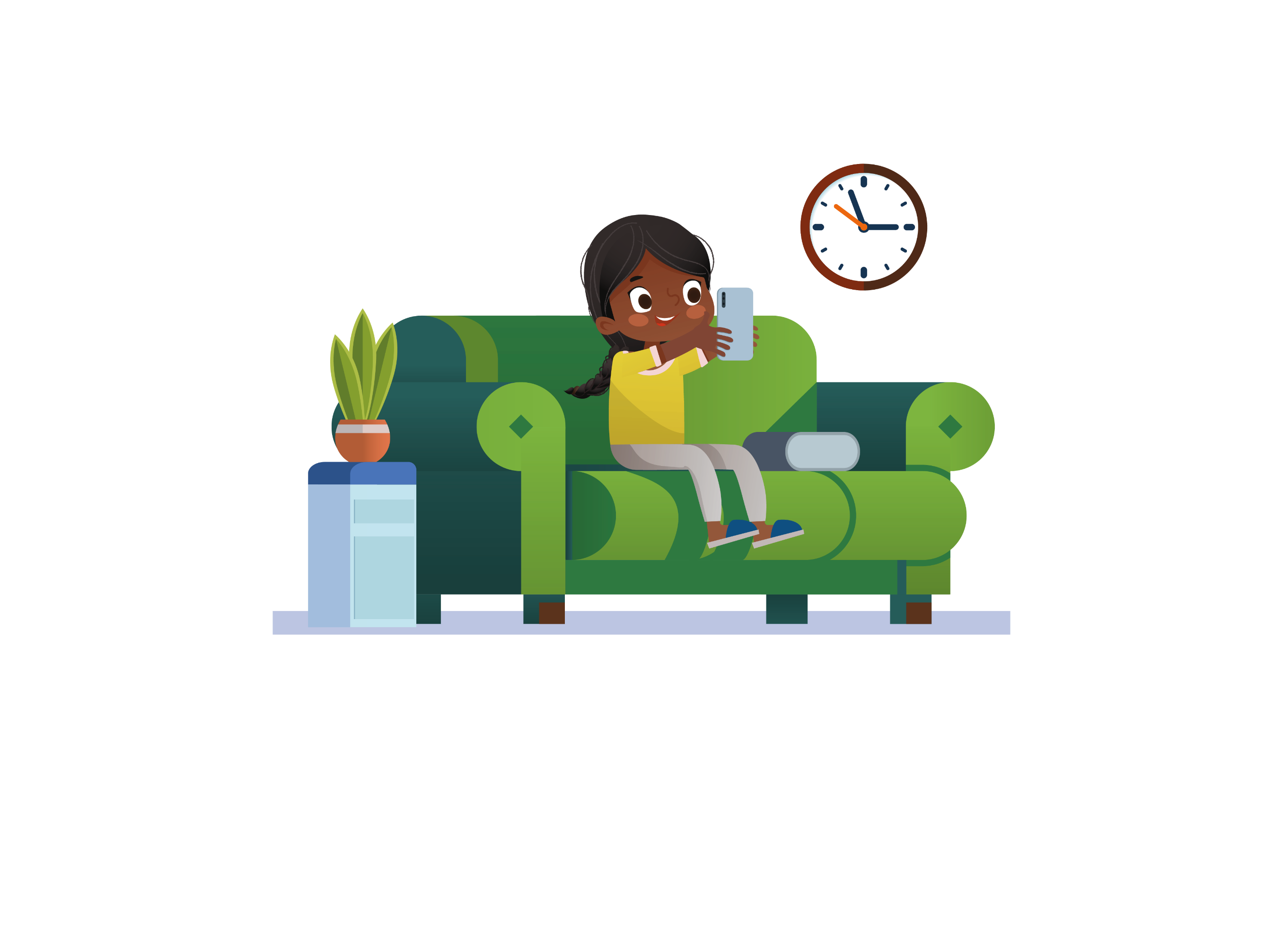
Uses of Social Networks
Sharing images
Tagging people and places
Talking about your day
Staying in contact with friends
Nothing on the internet is really only OURS!

Slide 7
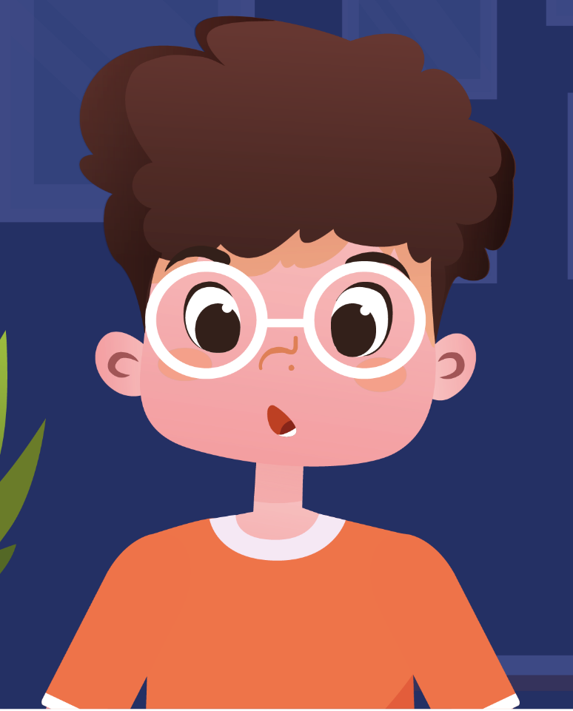
1
Set your profile as “private”
2
Only accept friend requests and chat with friends you know in person
3
Think before you post and only share content you are comfortable with
4
Respect your friends' privacy and make sure they do the same with you

Slide 8
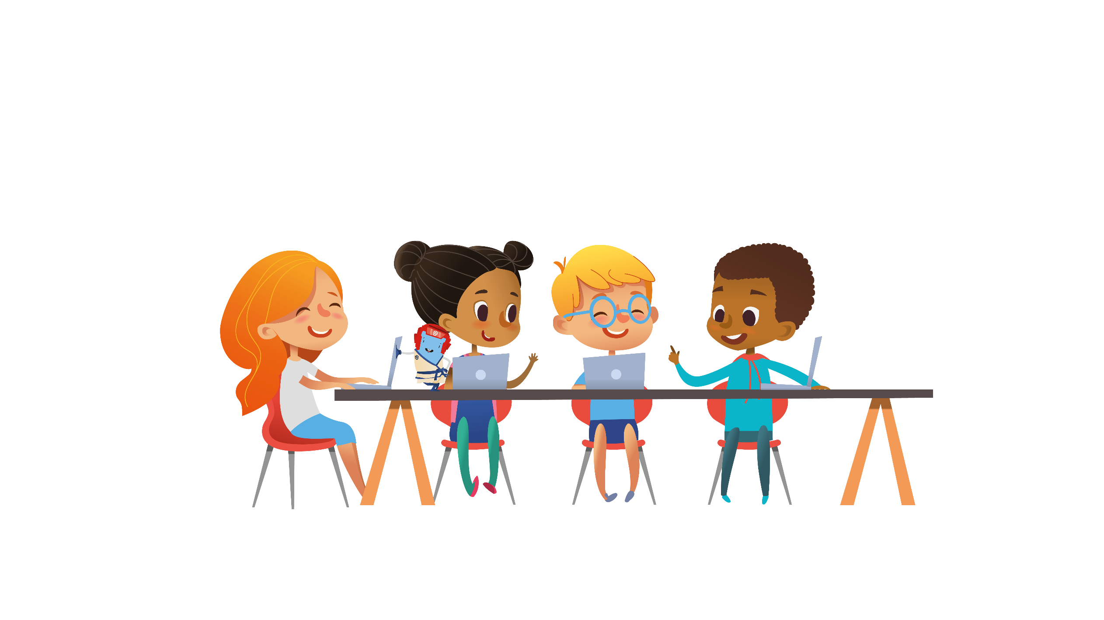
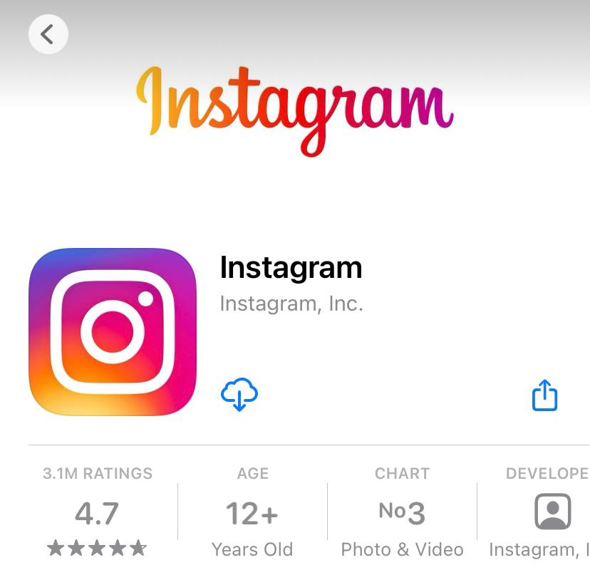
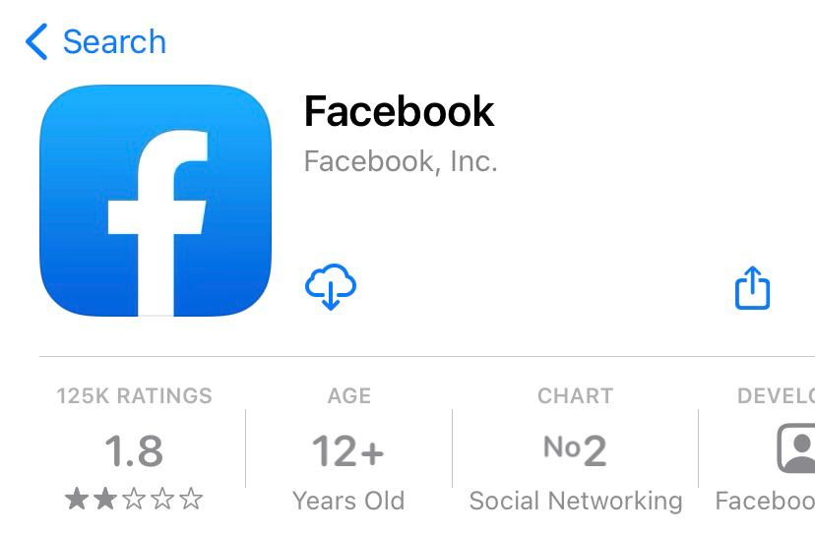
Not all social networks are adapted to your age…
… talk to an adult if you see something that makes you uncomfortable!

Slide 9
See you soon on www.itu-cop-guidelines.com

