Slide 2
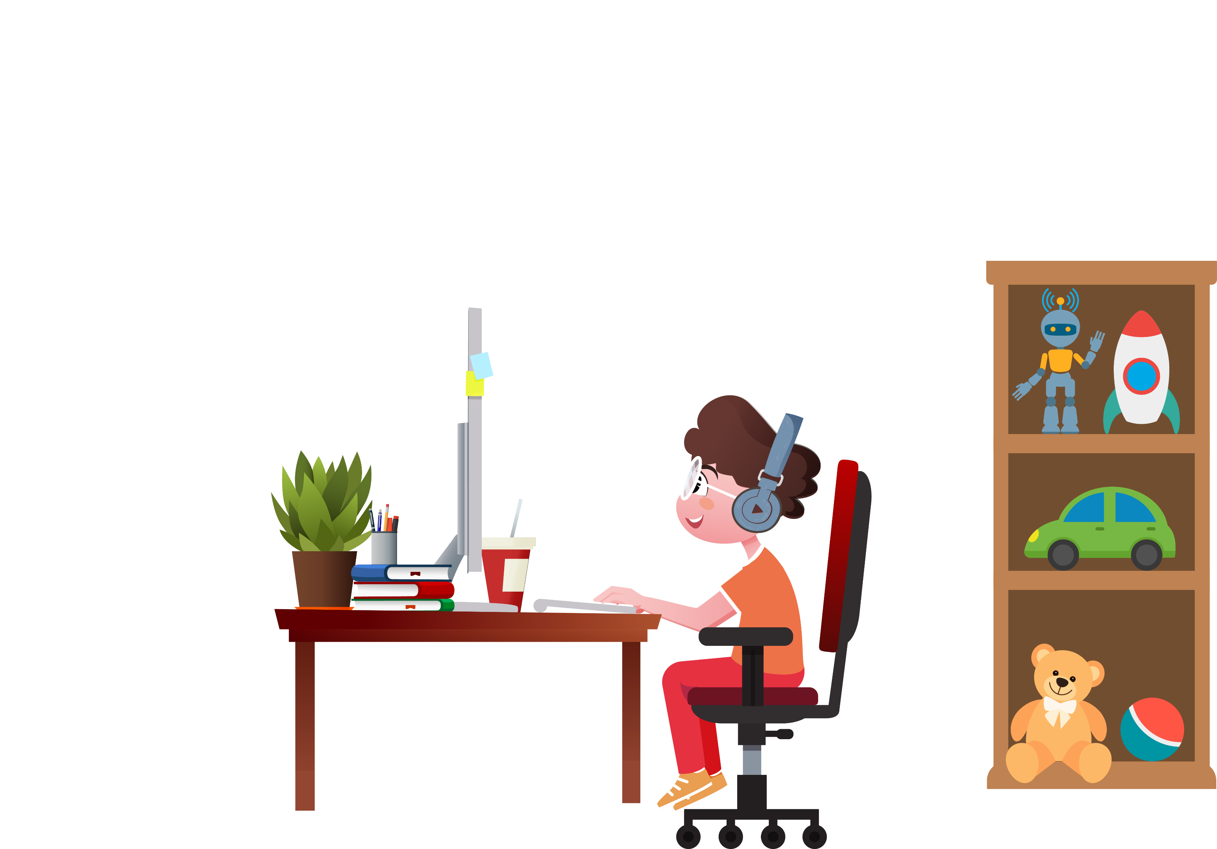
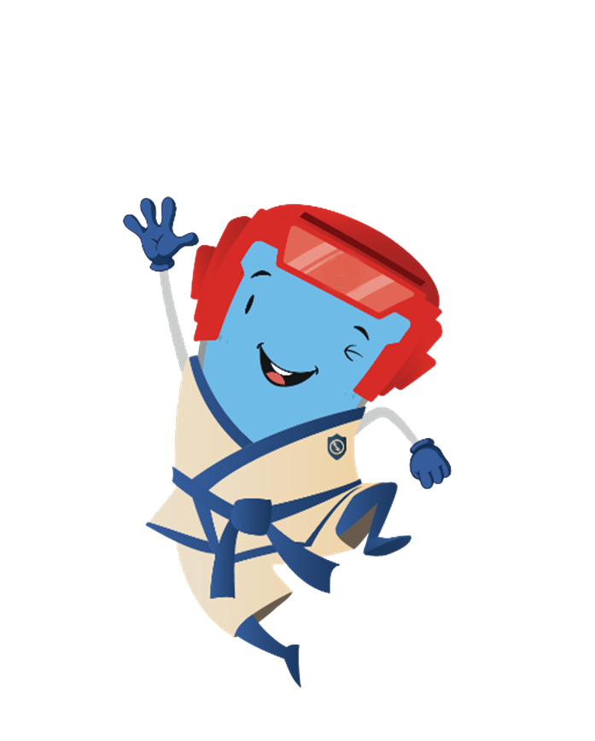
Hey
Nice to see you
Want to know
more about
cybersecurity

Slide 3
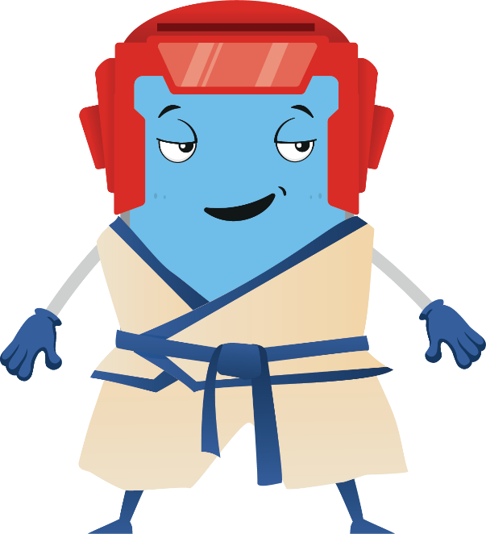
What do you use the internet for?
To communicate and stay connected with your friends and family
To watch TV shows
To play video games
To do your homework
To check your schedule online
To listen to music

Slide 4
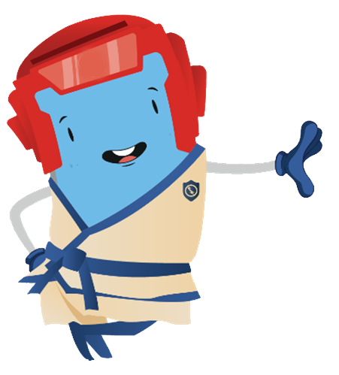
The internet can also be a
dangerous place
if we’re not careful about how
we act
when we’re online.

Slide 5
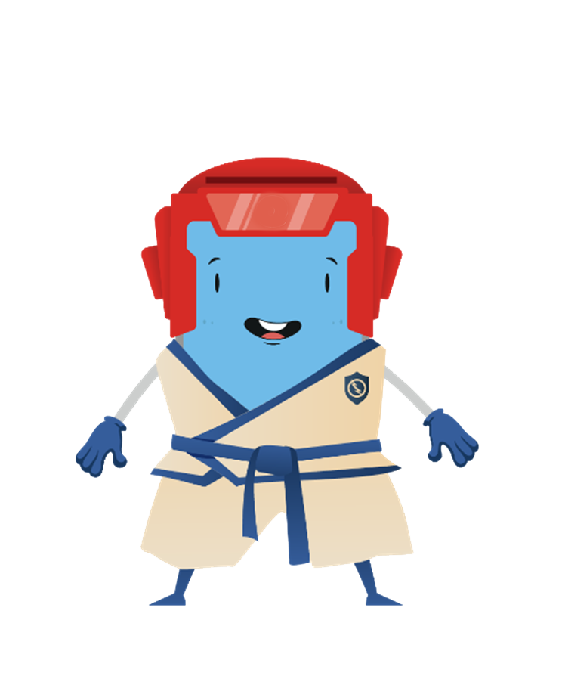
Today we will learn
how we can
protect ourselves
when we use the internet to communicate,
play and navigate.

Slide 6
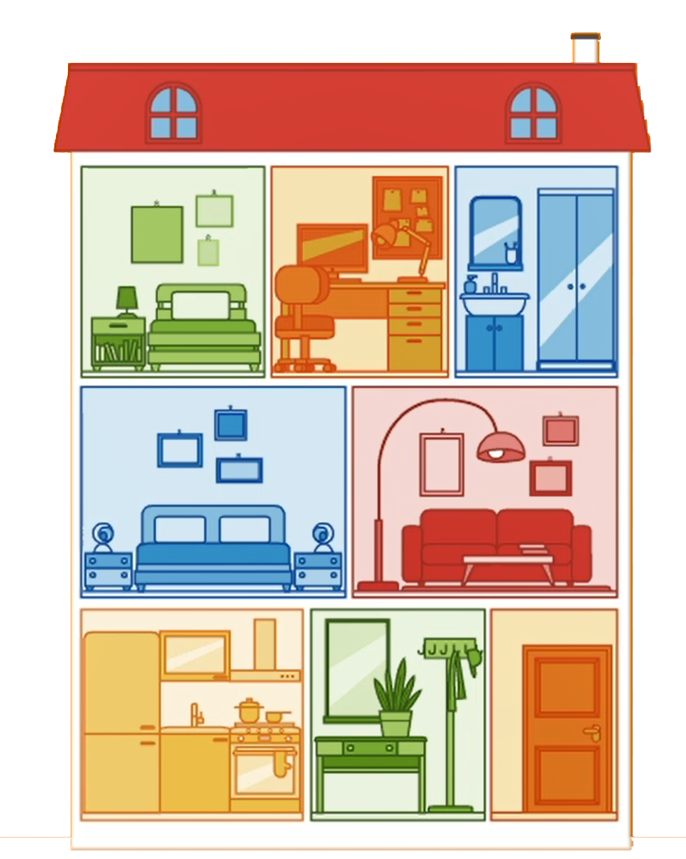
The house

Slide 7
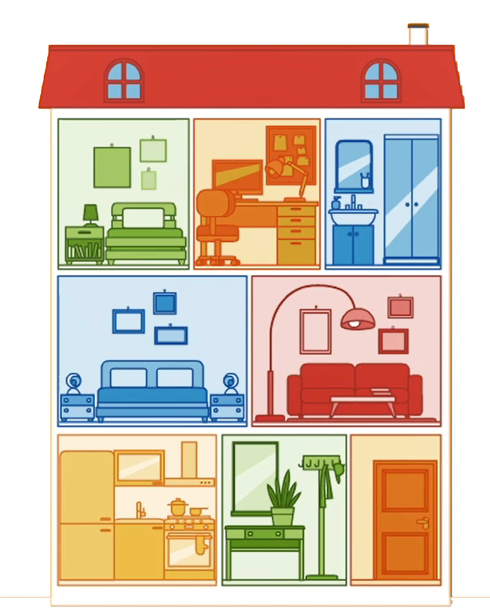
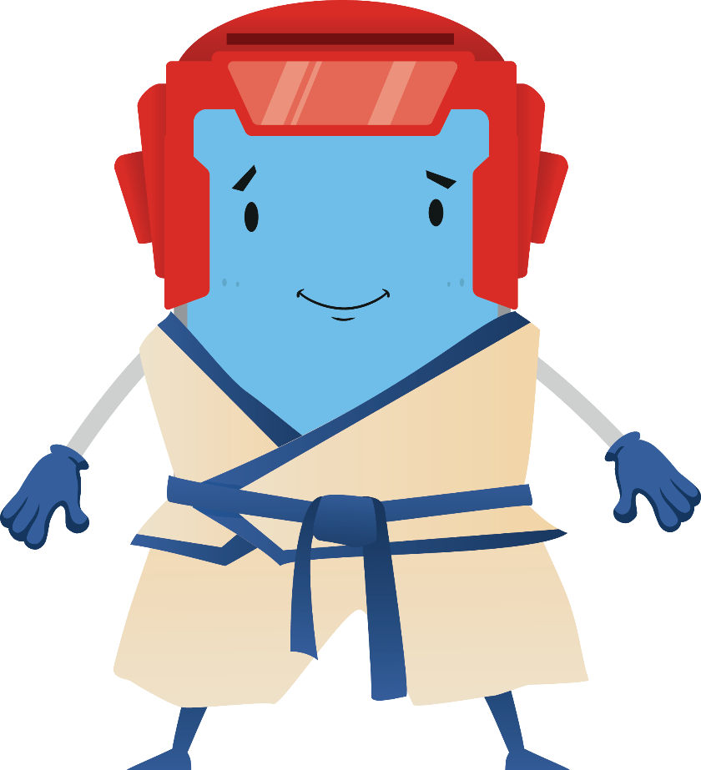
Your smartphone or your tablet are your
digital houses

Slide 8
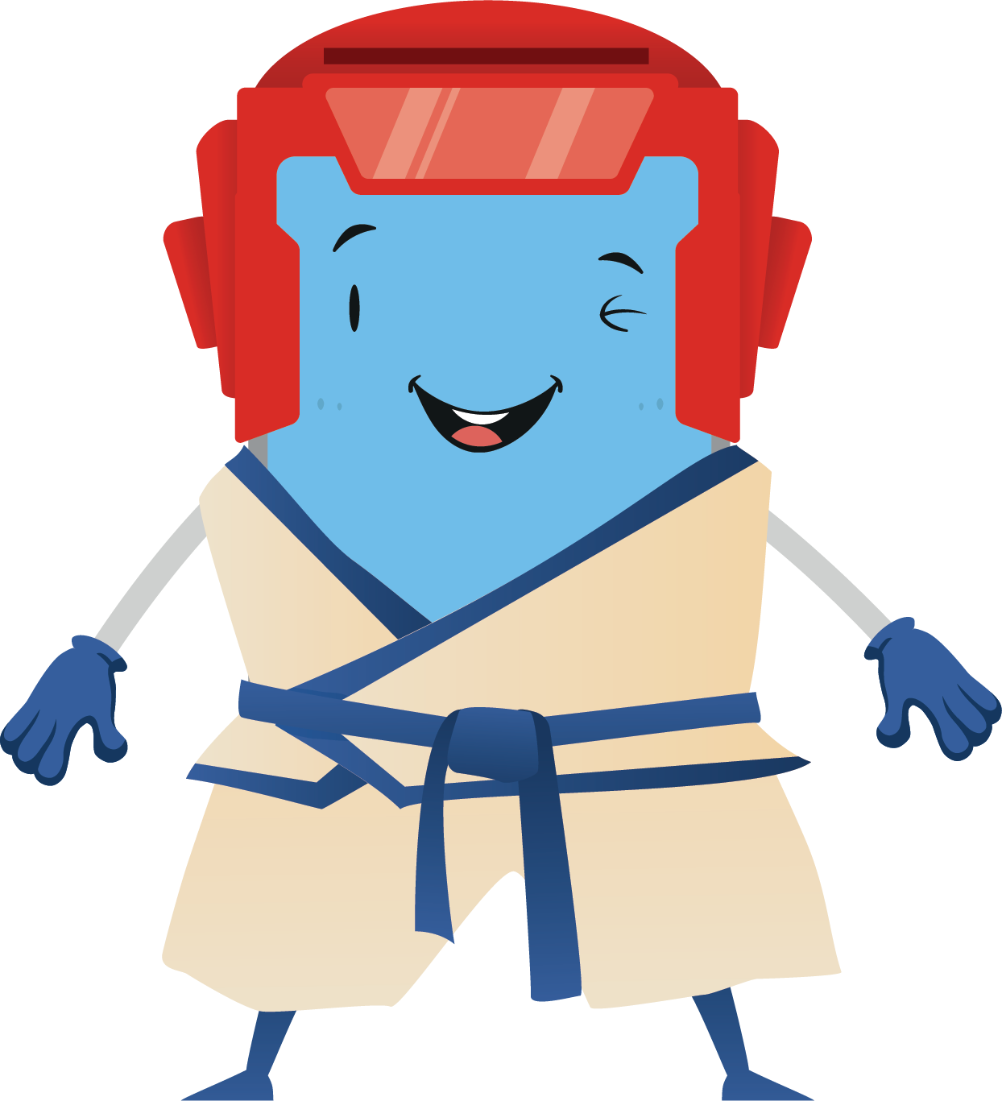
Apps are the rooms
of your digital house.

Slide 9
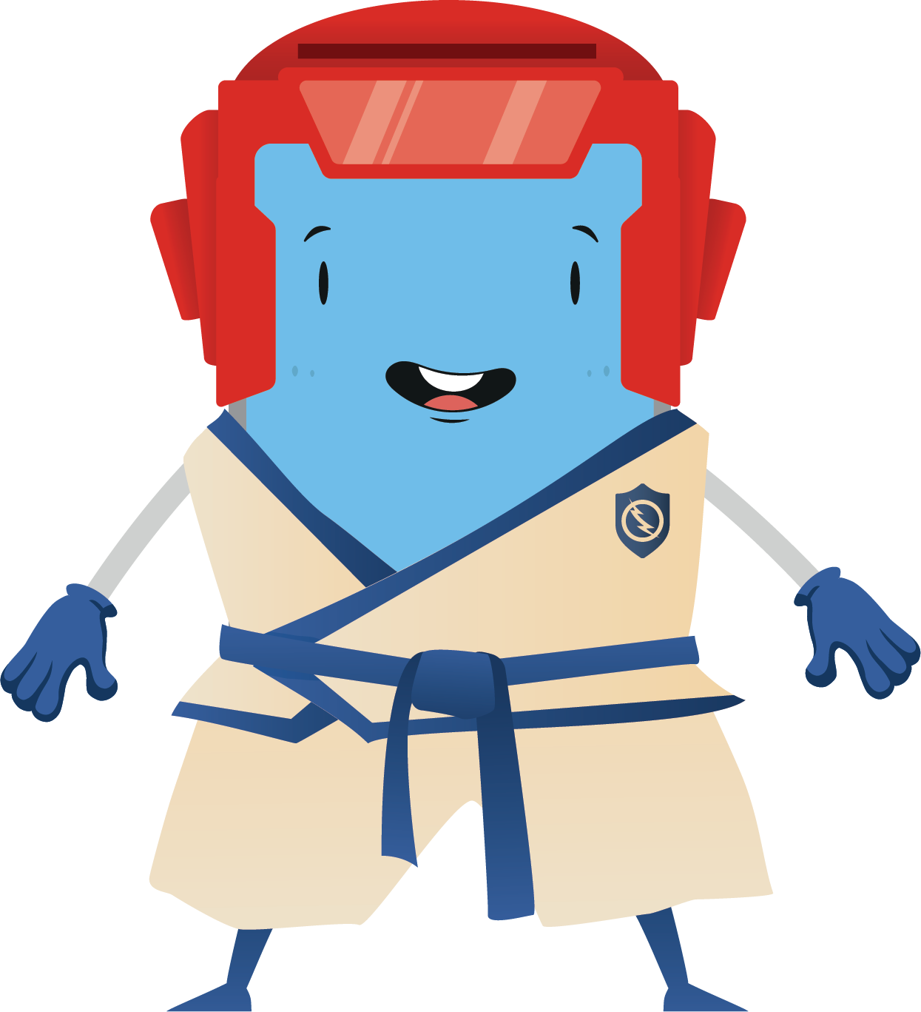
Your
password is the key
to your
digital house.
Would you
give it to
just anybody?

Slide 10
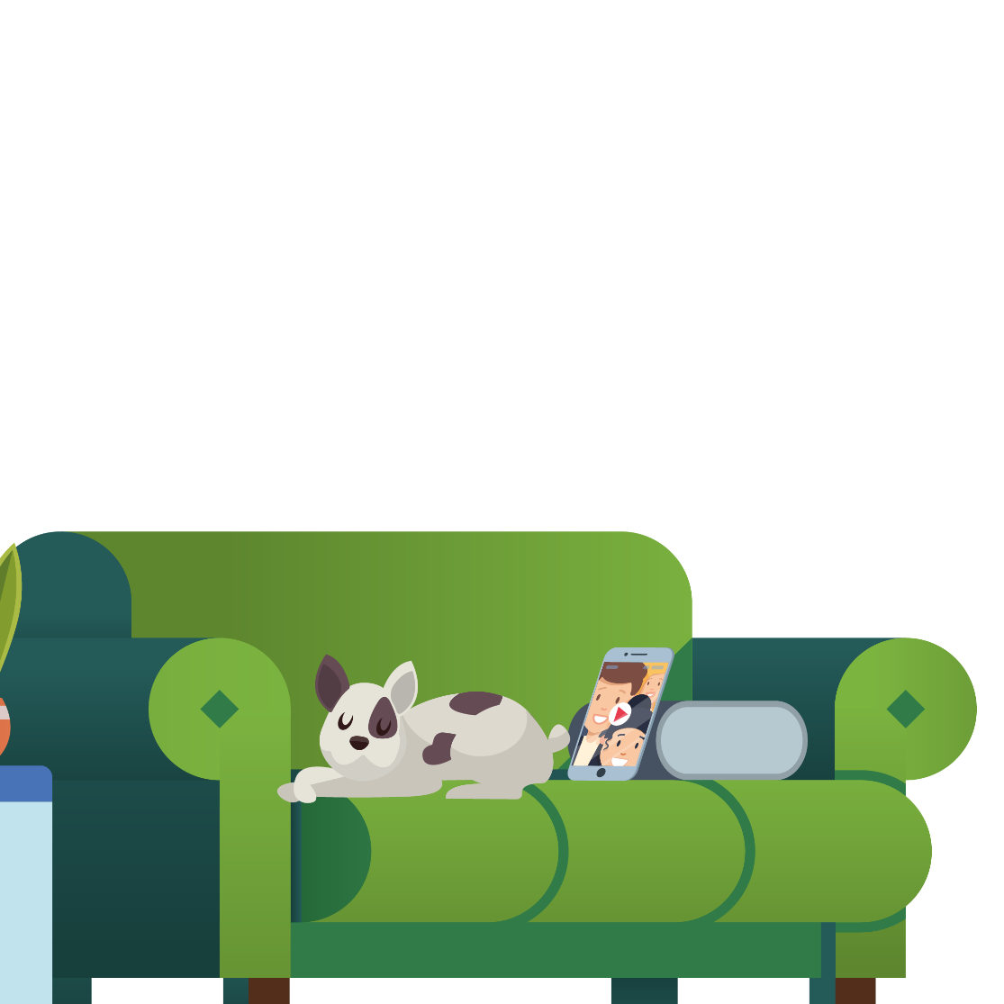
What do you need a password for?

Slide 11
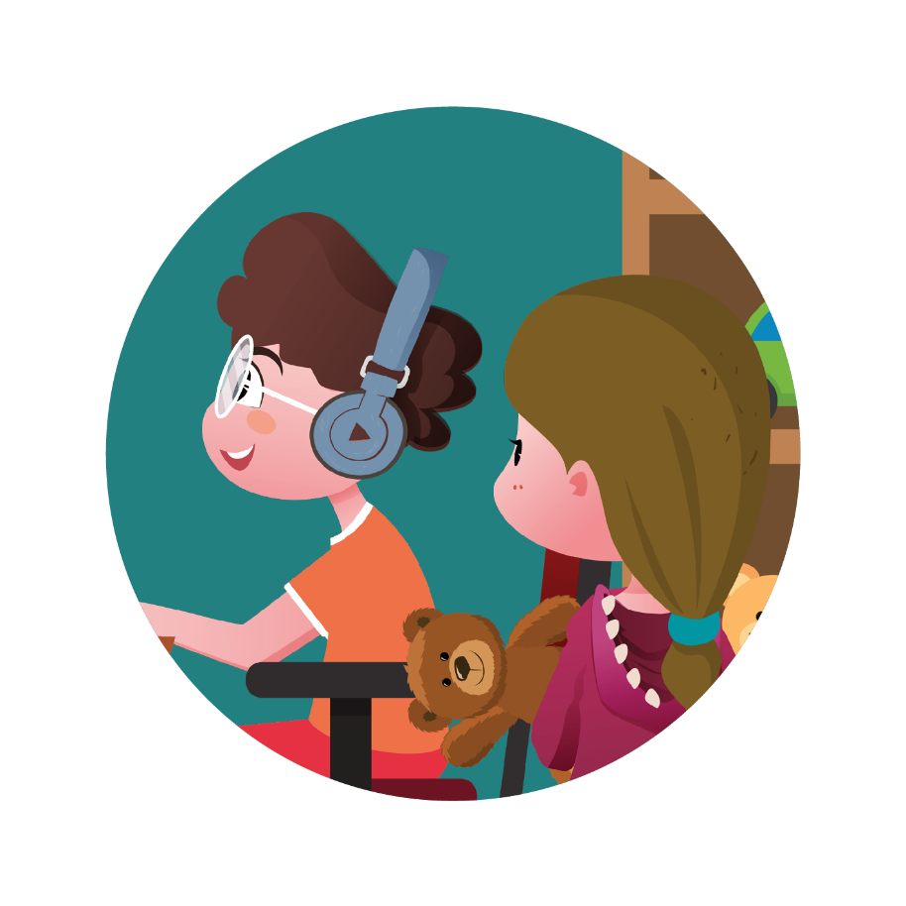
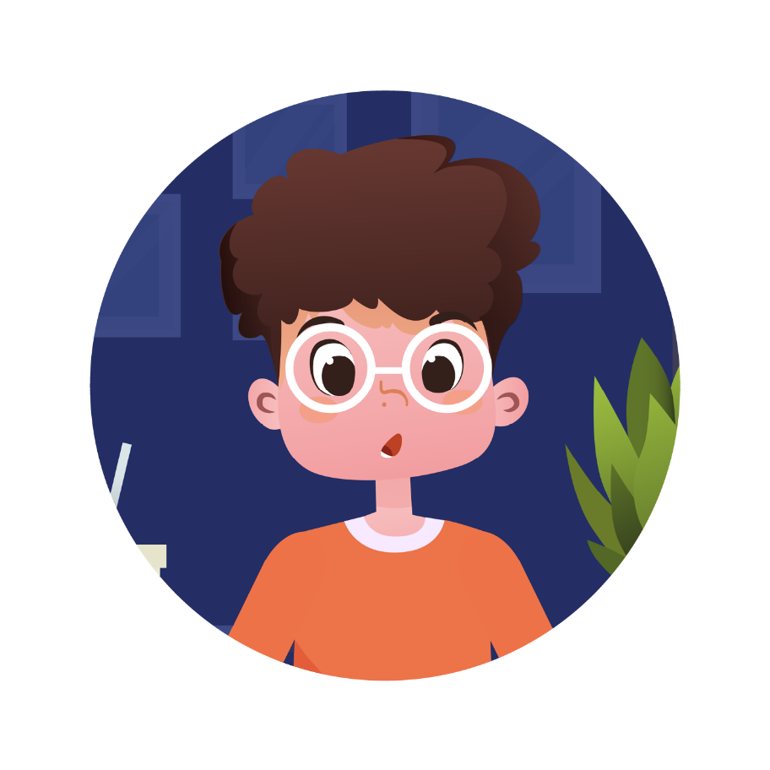
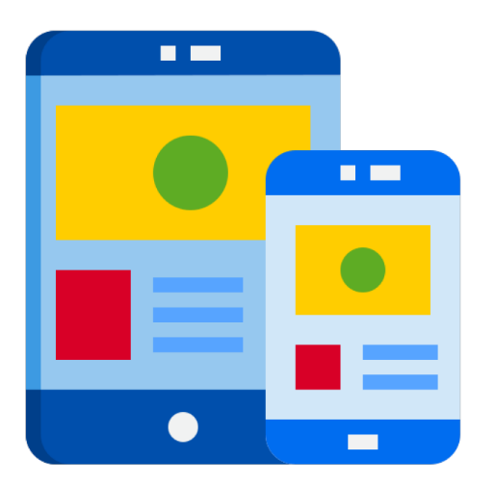
To protect yourself
To protect your family
To protect your activities

Slide 12
To protect yourself
My home address, my age, my school are all pieces of information that have to be protected because they are about me and the people I know!

Slide 13
To protect your family
When I use my family’s computer or smartphone,
I have to protect my personal information.
Strangers can use it to steal money from my family!

Slide 14
To protect your activities
Passwords also protect my track record on video games and the proper functioning of my electronic devices!

Slide 15
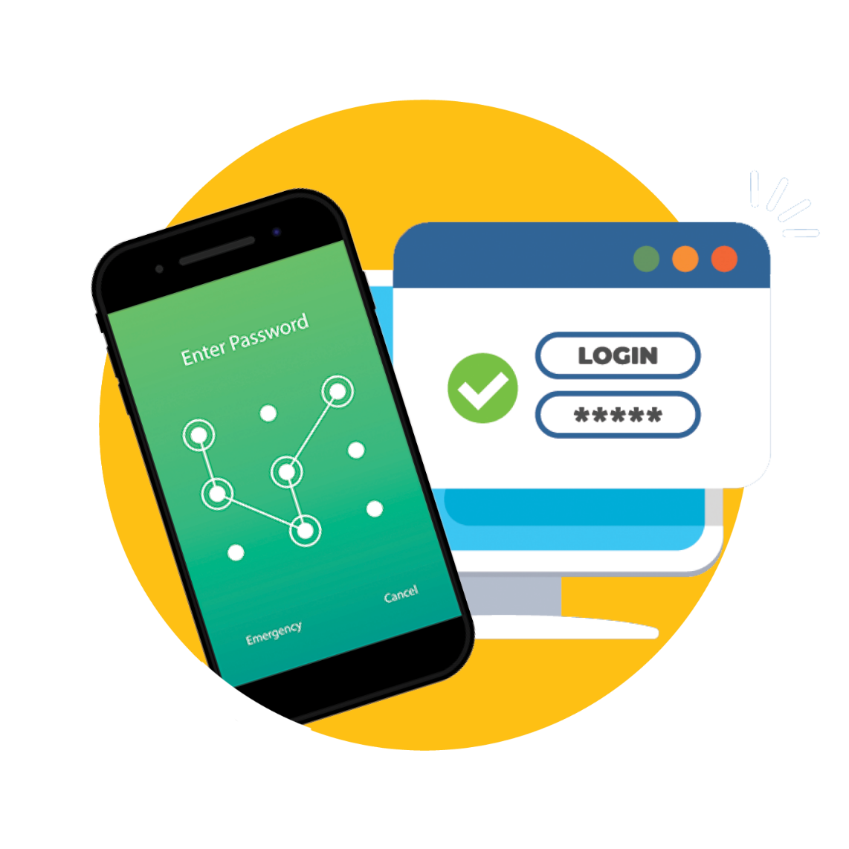
Setting up a password

Slide 16
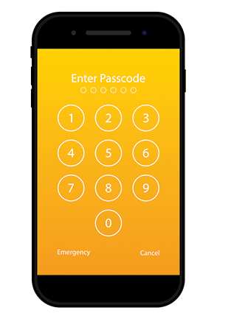
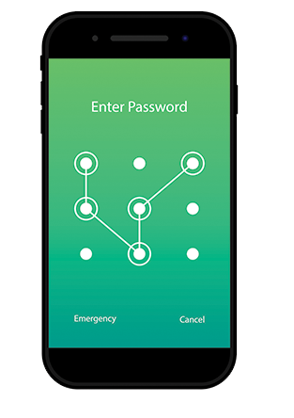
Remember to set a code of at least 6 figures or a combination to access your smartphone/tablet.

Slide 17
Leaving your smartphone/tablet
around and without a passcode
is like
leaving the door of your house open.

Slide 18
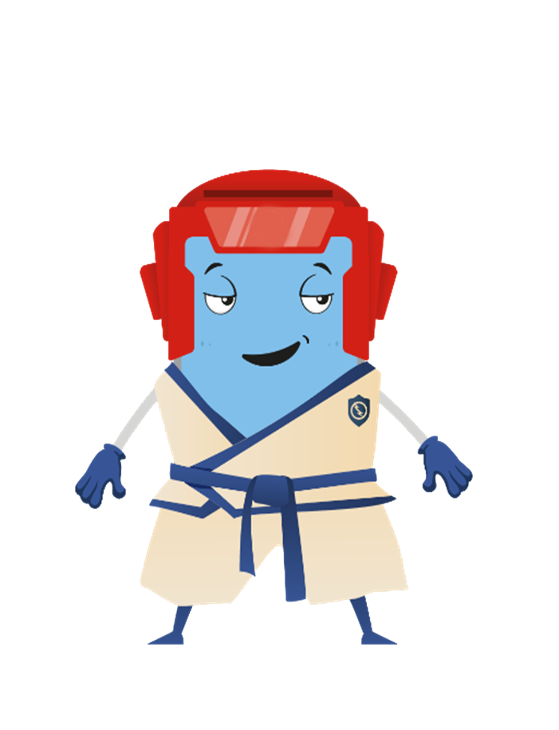
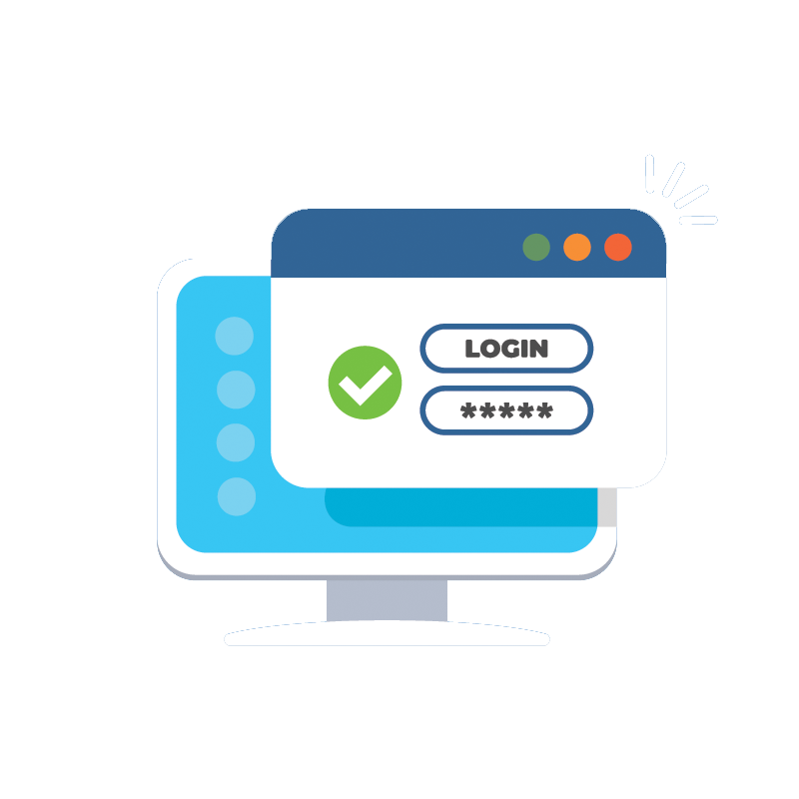
For a password to work, it must be
DIFFERENT from other passwords used on other accounts
LONG
COMPLEX

Slide 19
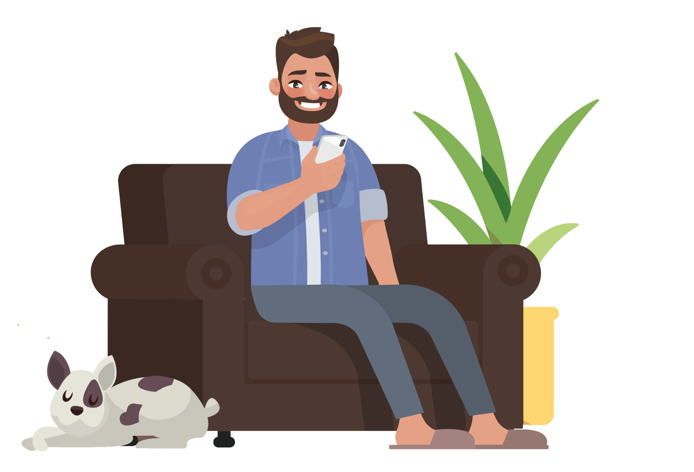
Include
Create your password
Numbers
9513164827
with an adult
A i C r V
Uppercase and lowercase letters
Punctuation
. % ( ) = ,

Slide 20
WINNER,
DO NOT CLICK!
CONGRATULATIONS,
A BARGAIN!!!!

Slide 21
See you soon on www.itu-cop-guidelines.com

